Slide 1
CRUCIAL CONVERSATIONS
Summer Athletic Directors Conference
August 5, 2019

Slide 2
Mike McGurk, CMAA Lee’s Summit North High School mike.mcgurk@lsr7.net Rich Bechard, CMAA Lee’s Summit School District rich.bechard@lsr7.net

Slide 3
Crucial Conversations
The root cause of many, if not most, human problems lies in how people behave when others disagree with them about high-stakes, emotional issues.
https://ytcropper.com/cropped/uc5d41d8f308a61
Notes:
Anytime you go after something worthwhile you are bound to have many crucial conversations.

Slide 4
Crucial Conversations
What’s a Crucial Conversation?

Slide 5
Crucial Conversations
Opinions Vary
Stakes Are High
Emotions Run Strong
Notes:
AD- Coach; Coach-player; Coach-coach; Coach-parent; AD-parent; AD-official; AD-principal; AD-student athlete; AD-asst.; AD- Media; AD-MSHSAA

Slide 6
Crucial Conversations
When the stakes are high.
You can’t be silent about things that matter!
https://ytcropper.com/cropped/uc5d41da681fc06
Notes:
Anytime you go after something worthwhile you are bound to have many crucial conversations. If you want to avoid crucial conversations lead a meaningless life.

Slide 7
Crucial Conversations
Many crucial conversations turn to violence or silence when not done correctly.
The ability for an athletic administrator to be able to have crucial conversations is paramount.

Slide 8
Crucial Conversations
Start With Heart
Stay Focused on What you Really Want
Notes:
If you can’t get yourself right, you’ll have a hard time getting the dialogue right. Work on me first - us second. Getting yourself right- talking to a colleague.

Slide 9
Crucial Conversations
At the core of every successful crucial conversation lies in the
FREE FLOW OF RELEVANT INFORMATION

Slide 10
Crucial Conversations
Make it Safe
https://ytcropper.com/cropped/uc5d41db32513ba
Notes:
In order to deliver a delicate message they must believe your care and value them as a person and their goals and objectives.
When this is not in place people tend to turn toward silent or violent.

Slide 11
Crucial Conversations
How To Have A Crucial Conversation
Share your facts
Tell your story
Ask for others’ paths
Talk tentatively
Encourage testing

Slide 12
Crucial Conversations
Share Your Facts
Notes:
I saw . . .
I heard . . .
I notice . . .

Slide 13
Crucial Conversations
Tell Your Story
Notes:
It looks to me like . .
Starting to believe . .

Slide 14
Crucial Conversations
Ask For Others’ Path
Notes:
How do you see it?
I’m I off base?
What are your thoughts?
What do you think is going on?
Focus on listening not what you want to say next.

Slide 15
Crucial Conversations
Talk Tentatively
Notes:
The fact of the matter ... - In my opinion …
That’s a dumb idea . . - Maybe it would make more sense to . .
The only reasonable option is to . . - I believe what we should do is . .
If I agreed with you, then we’d both be wrong . . - I’m wondering if that example applies to our programs . .

Slide 16
Crucial Conversations
Encourage Testing
Notes:
Tell me more about that . .
I recognize I may only have part of the story . .

Slide 17
Crucial Conversations
Learn to Look
For the signs that a conversation is turning crucial
For early warning signs of silent and violence
Notes:
Learn to look for signs that the conversation is turning to violent or silent

Slide 18
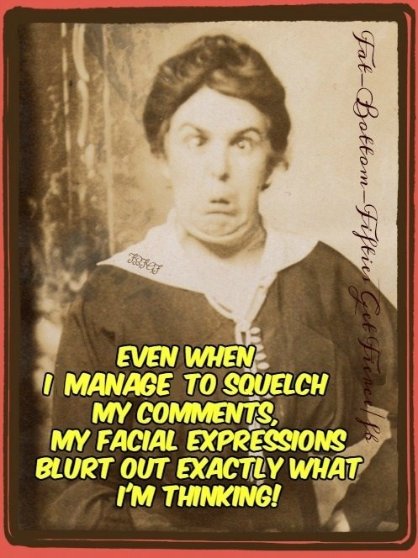
Crucial Conversations

Slide 19
Crucial Conversations
When Silent or Violent Occurs Explore Other’s Path
Ask: “I want to know what you think about . . .”
Mirror: (Silence) “You seem reluctant. Are you sure you’re OK with it?” (Violence) “Wow, you seem really upset. What’s up?”
Paraphrase: “So what you are saying . . . . “
Prime: Do you think that . . . .?”

Slide 20
Crucial Conversations
Move to Action
Determine WHO, does What, by WHEN, and how we will FOLLOW UP.

Slide 21
Crucial Conversations
Informal Opportunities
All Conversations Can be Deemed Crucial

Slide 22
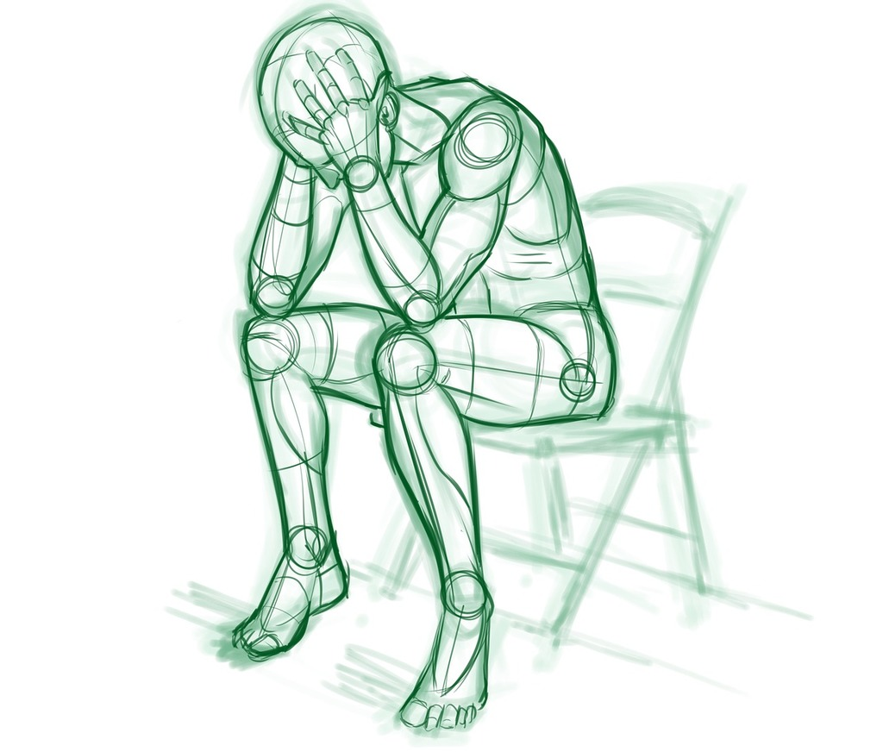
Crucial Conversations
Many Issues in an Organization are Caused by People Staying Silent

Slide 23
Crucial Conversations
Genuine Dialogue With Others
Can transform people and relationships
Bonding can take place which results in trust and loyalty
Move you and others to a higher level of mutual understanding
https://www.youtube.com/watch?v=hKBOZVWYfzQ

Slide 24
Crucial Conversations
You may have great skills to carry on a crucial conversation and the other person still doesn’t want to dialogue, thus you won’t get dialogue.
However, if you persist over time, refusing to take offense, making your motive genuine, showing respect, and constantly searching for mutual purpose, then the other person will almost always join you in conversation.

