Slide 1
Improving Communication for ATs
Tony Harris MS, LAT
Citizens Memorial Hospital
Sports Medicine Center
Bolivar, MO
Notes:
Loading screen Rapport and UFC

Slide 2
Communication
w/ Healthy Roster
Text chat
Group text chat
Video chat & Scheduled Video Chat
Injury alerts
Injury timeline communication
eFax

Slide 3
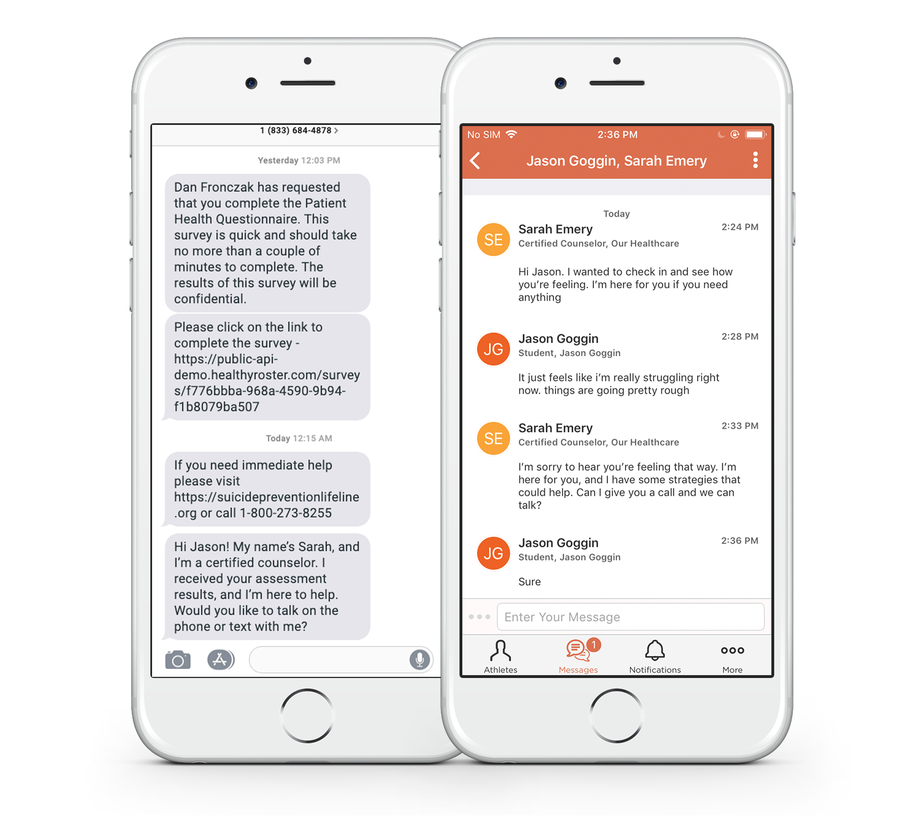
Text Chat
Improve trust with better communication
1x1 safe communication
Send photos/documents
Communicate from anywhere
Don’t give out your cell # anymore
Protect yourself with documented communication around injury

Slide 4
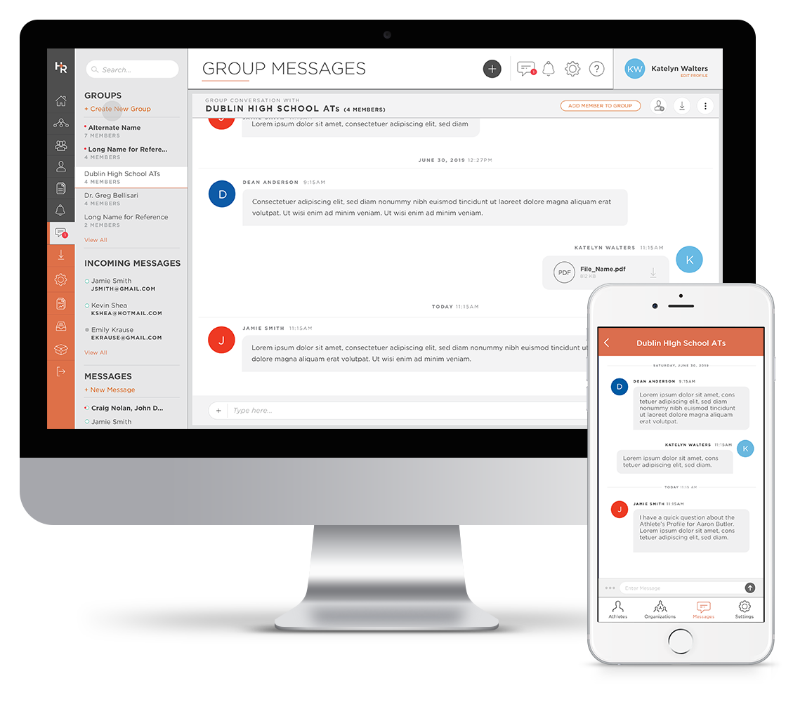
Group Text Chat
Simple Mass communication
Share documents easily
Control responses
Communicate from anywhere
Prevent PHI from being shared

Slide 5
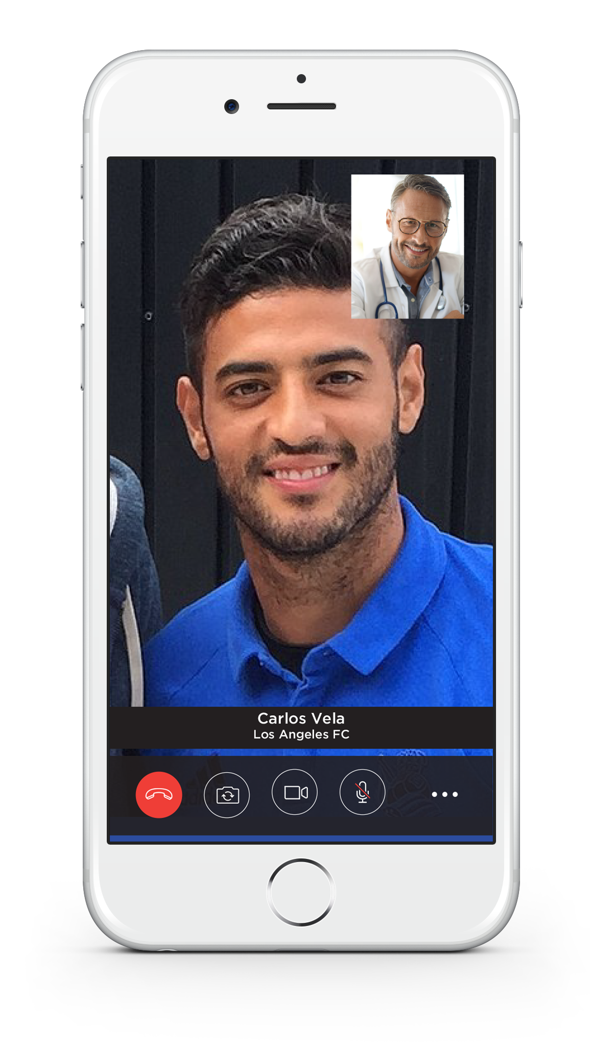
Video Chat
Remote treatment/assessments
Control your calendar with scheduled visits
Quick launch with one-click
Secure and HIPAA Compliant
Extends yourself when not on road with team

Slide 6
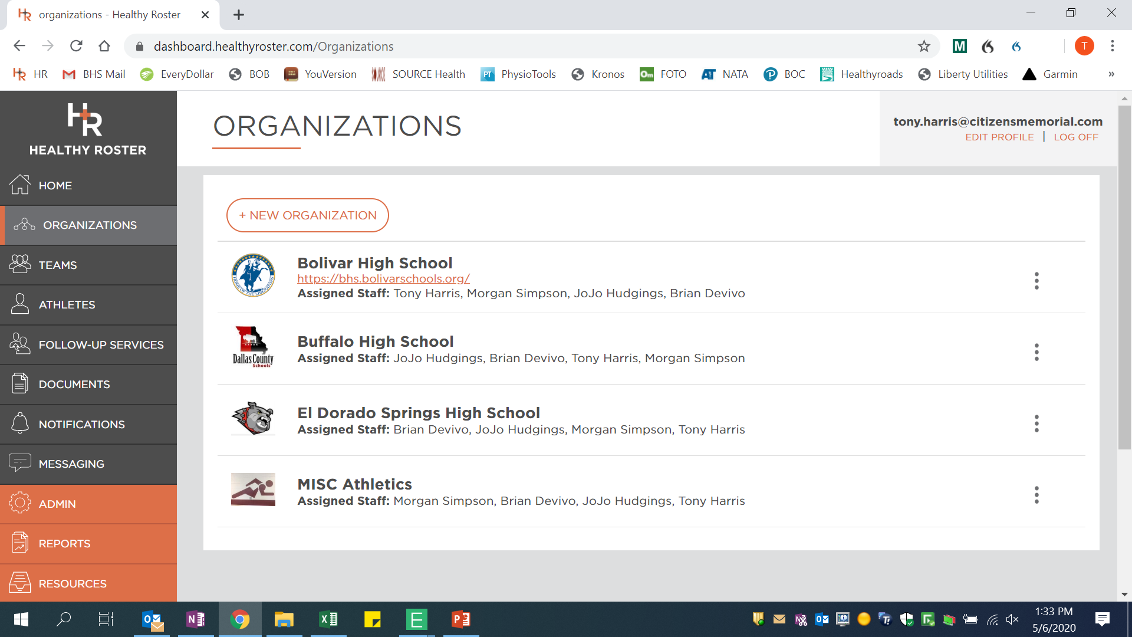
Organizations List
All your organizations are listed in one place
As the administrator, you assign everyone to their correct organization
Can have as many as you need including separating high school from middle school

Slide 7
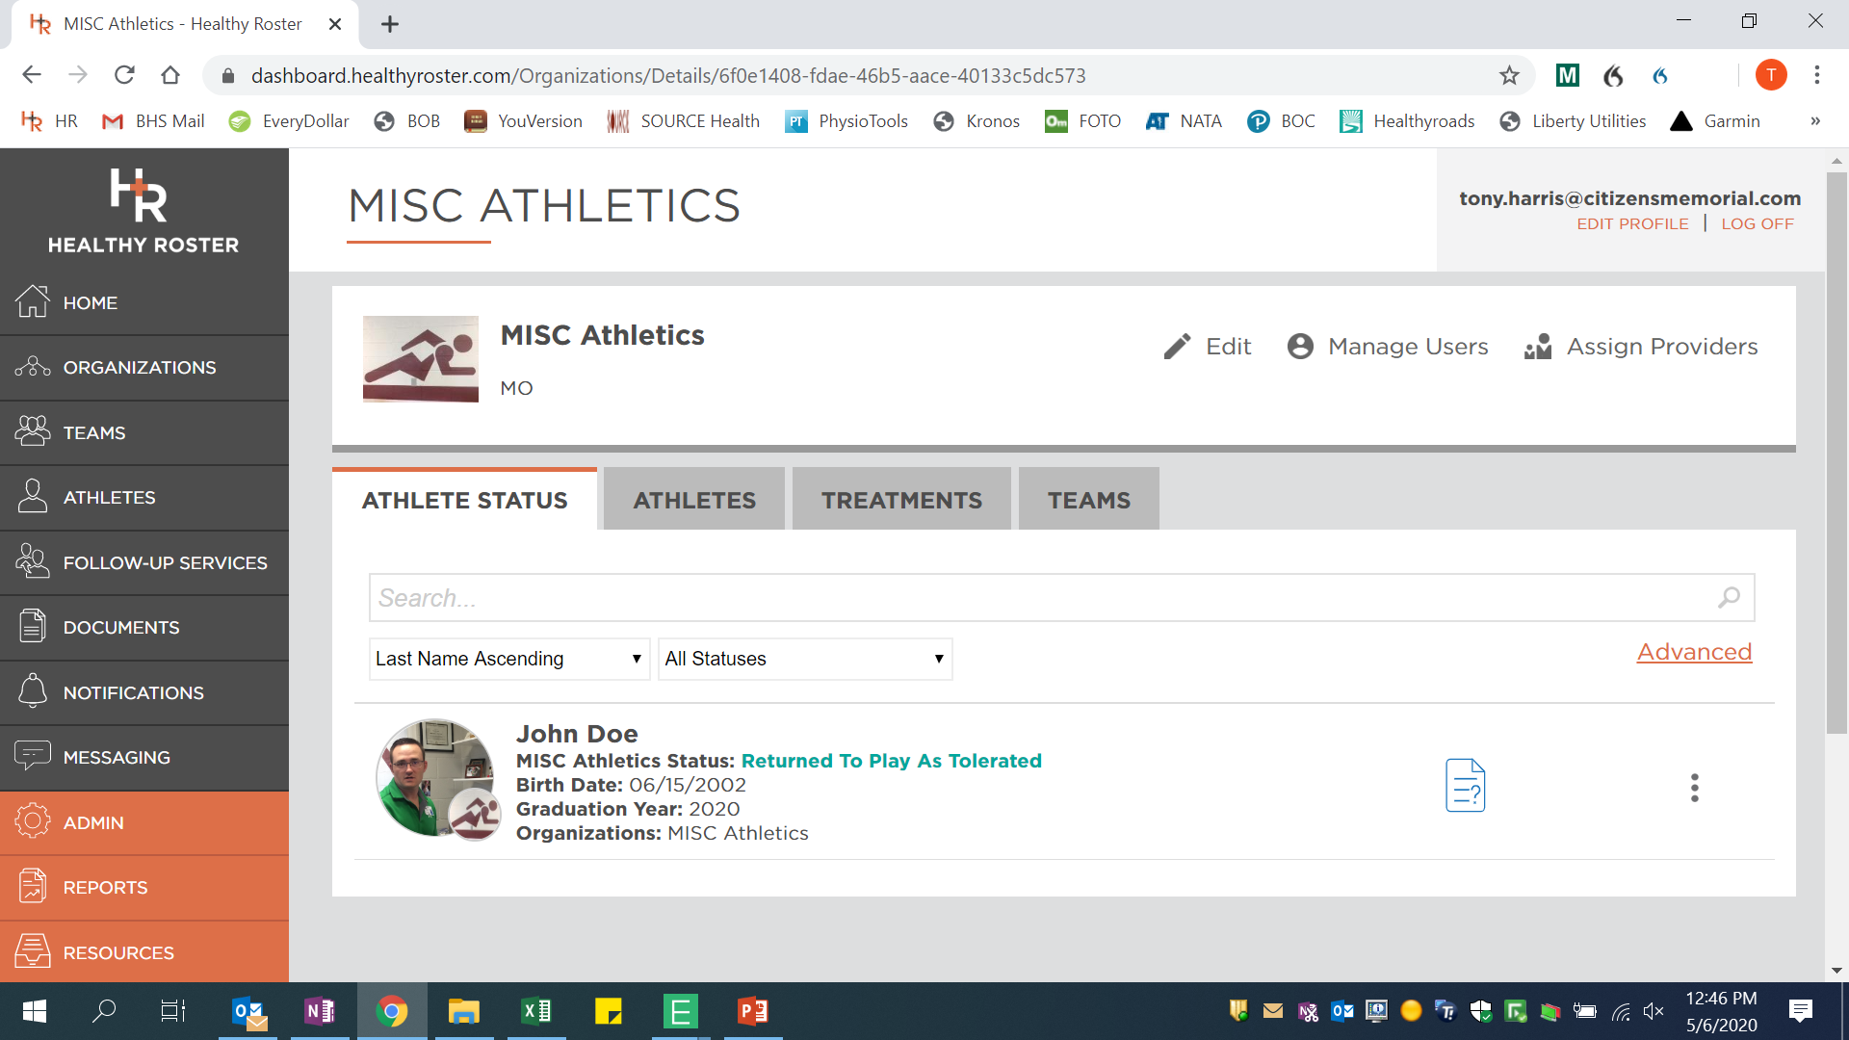
Organization Home Screen
Athlete Status
Athletes
Treatments
Teams

Slide 8
Athlete Status
Any athletes with an open injury will be listed here
Injuries listed as the following: Returned to play as tolerated, Limited activity, or Not cleared.
They are color coded for easy identification

Slide 9
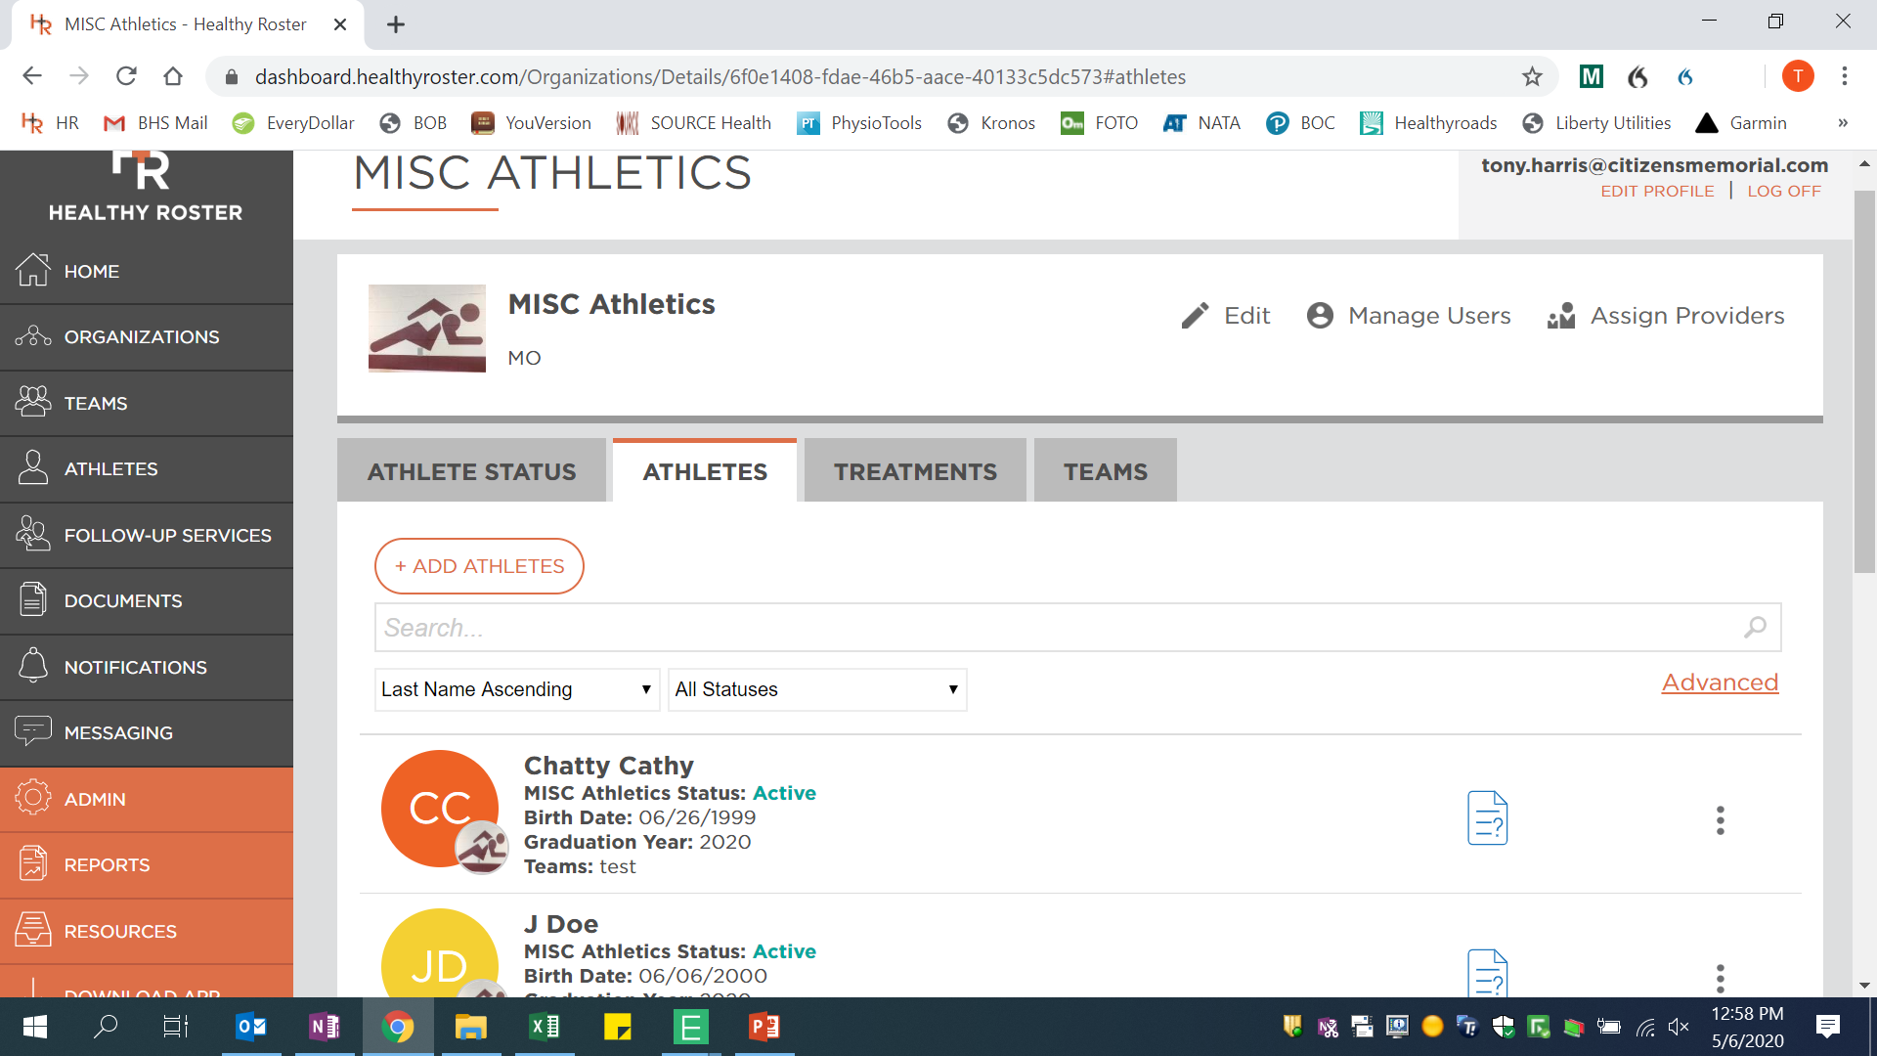
Athletes
All athletes in the organization will be listed here
Athletes can be added to the organization here
Search bar makes finding and athlete much quicker
Can adjust the list according to name or status

Slide 10
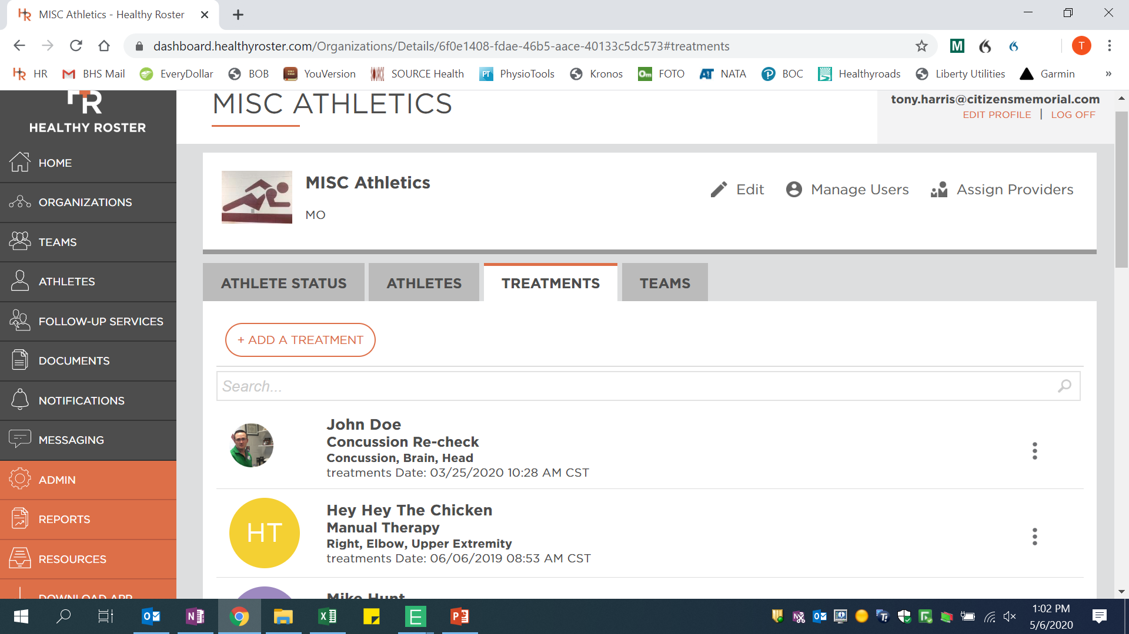
Treatments
Athletic Trainers can add treatments in here for the athletes
The treatments that have been confirmed through the treatment kiosk will show up here as well
This gives a record of what is being done in the Athletic Training Room each day
Can attach a dollar amount to each procedure done: ankle taping, injury evaluation, stretch, therapeutic exercise.

Slide 11
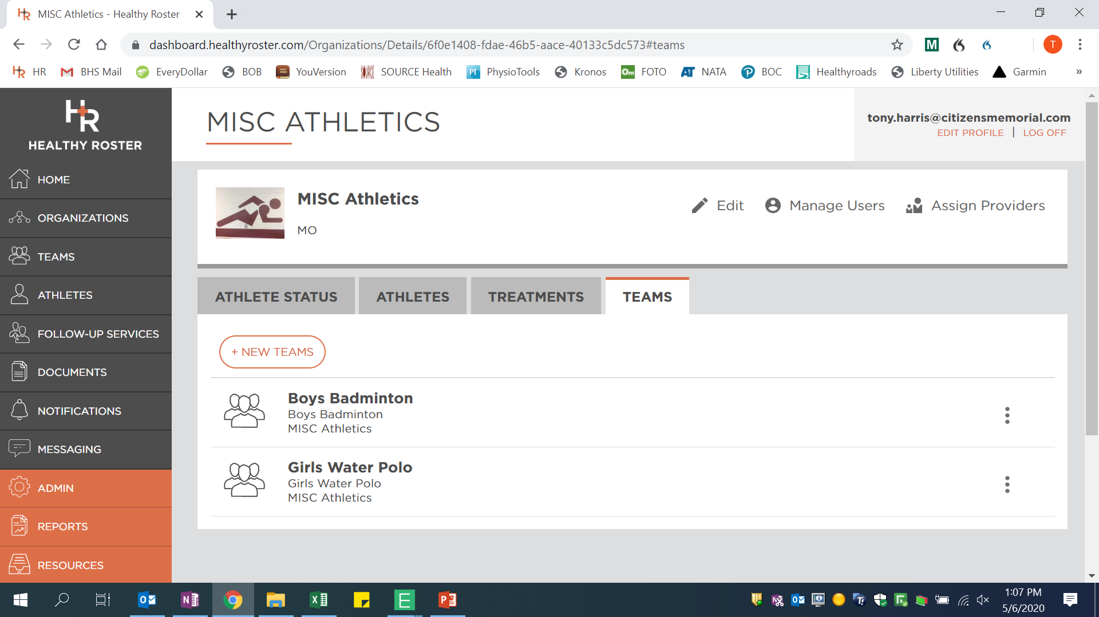
Teams
All teams under the organization will be listed here
Teams can be added here
Logos for each team can be added as well

Slide 12
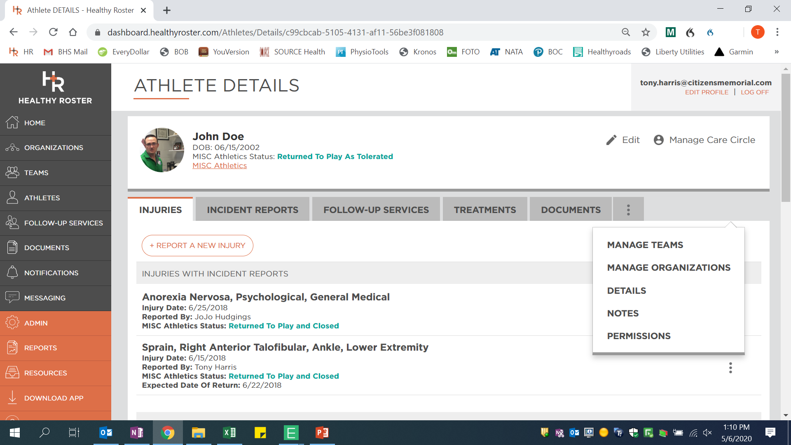
Athletes Dashboard
Athletes DOB, injury status, teams, and organizations listed here
There are several tabs on this screen: Injuries, incident reports, follow-up services, treatments, documents, and others

Slide 13
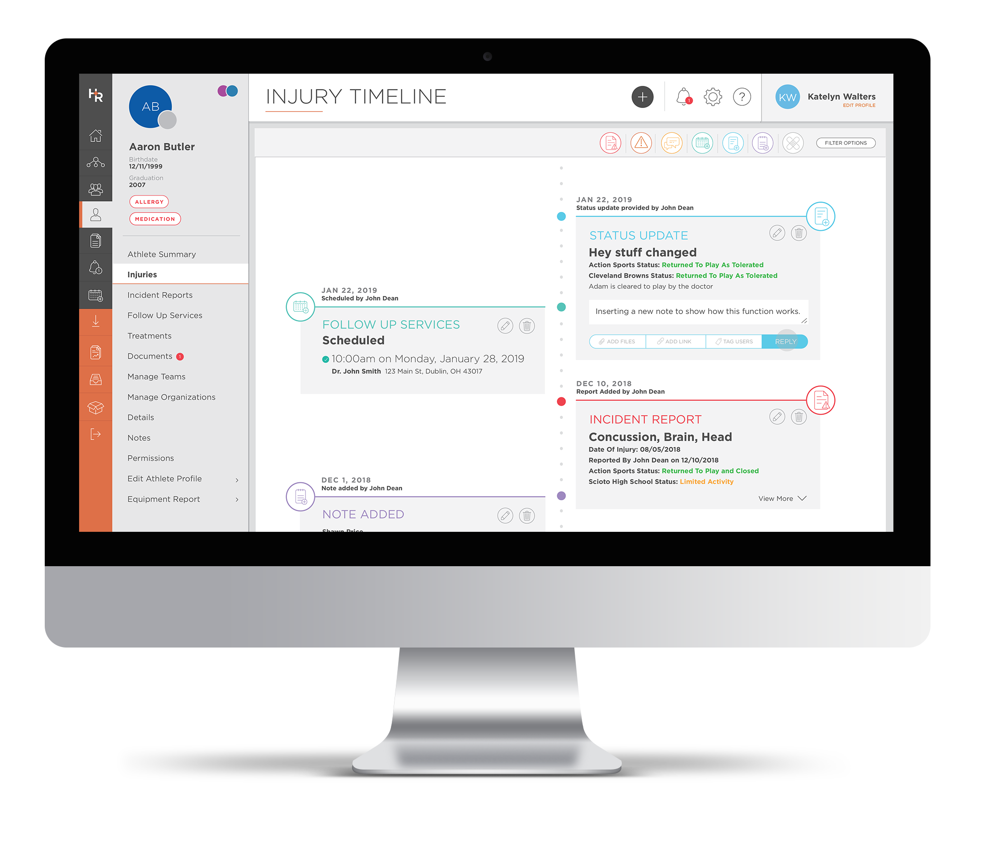
Injury Alerts/Timeline
Communication
Receive/answer questions about injuries
Keep all parties on the same page
Uniform Injury updates
Automatic notifications
Timeline creation for dialogue around injury
Ability to add rehab resources to timeline

Slide 14
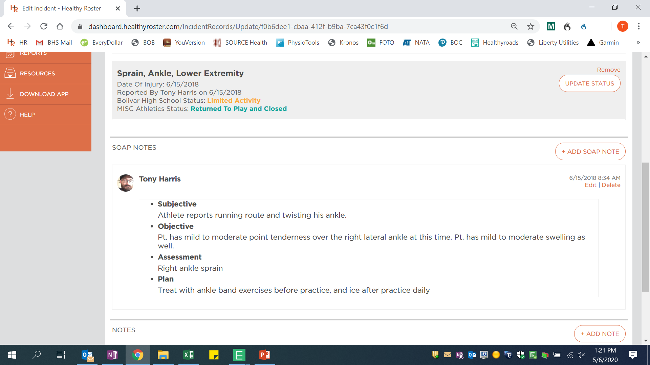
Incident Reports
The incident report allows the Athletic Trainer to document their evaluation and assessment of the injury
This is where they would perform the legal documentation required in case of legal action

Slide 15
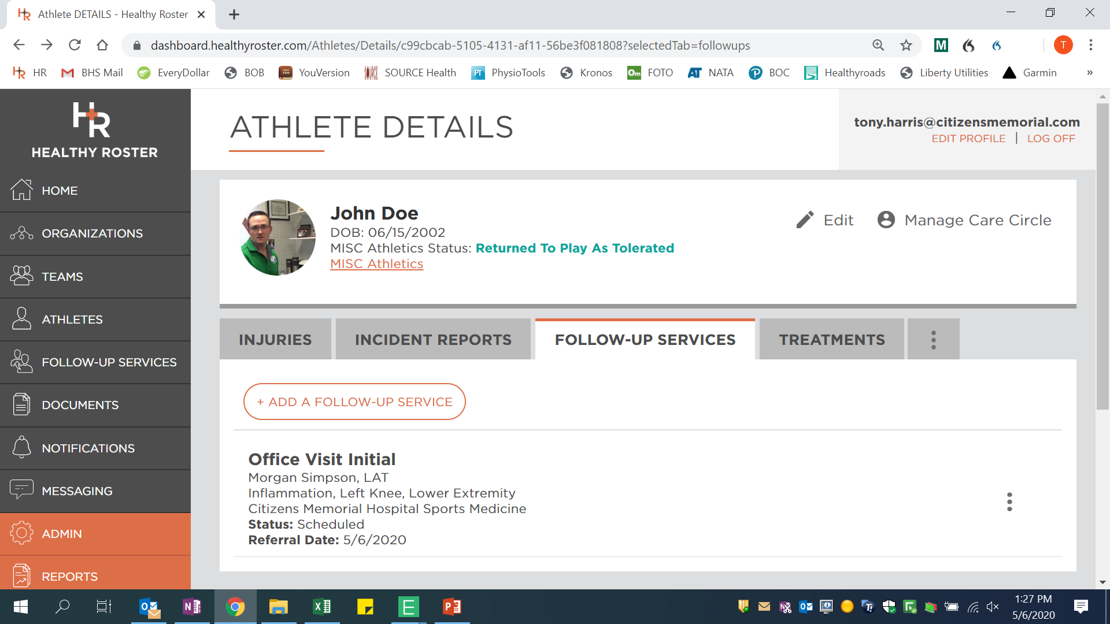
Follow-up Services
When referrals are made for the athlete, they will be placed here
This allows tracking of what is happening with the athletes injury when outside of the school

Slide 16
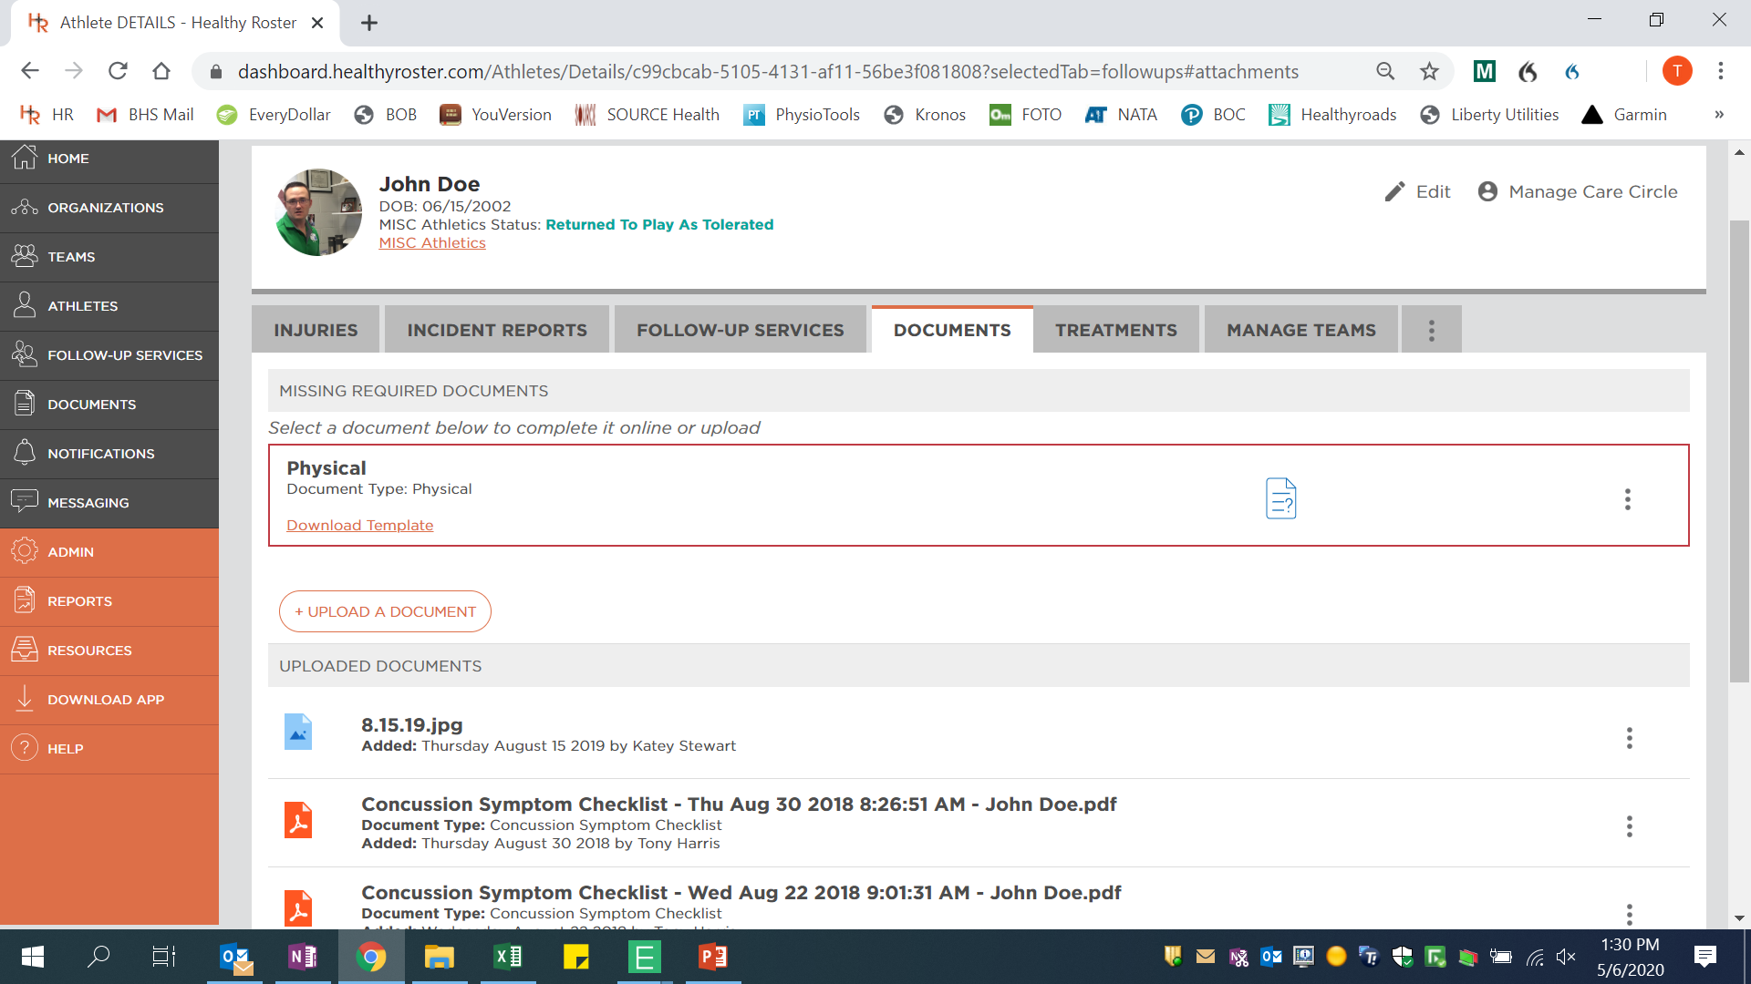
Documents
Physicals, Insurance, Doctors notes, Pictures of injuries, School required documents to practice
All the documents for each athlete can be stored here, and accessed by those with access to the athlete
Coaches no longer would have need to carry paper copies of physicals

Slide 17
Cost of Using Healthy Roster
The cost is $500 per year, per provider (Athletic Trainer, Physician, Nurse outside of the school, Psychologist)
If your school contracts with a hospital or clinic to provide an Athletic Trainer, you might get them to purchase it
Other than the providers, it is absolutely free for everyone else (Administration, Coaches, Parents, and Athletes)
Other charges you could come across are having Healthy Roster creating electronic forms for you

Slide 18
Improving Communication for ATs
HEALTHYROSTER.COM

