Slide 1
Waynesville High School Tiger Performance Training

Slide 2
TASK FORCE
HEAD COACHES
DEVELOPMENT OF GOALS
IDENTIFY A HEAD TRAINER
COLLECTIVE COMMITMENTS
PROGRAM SACRIFICES

Slide 3
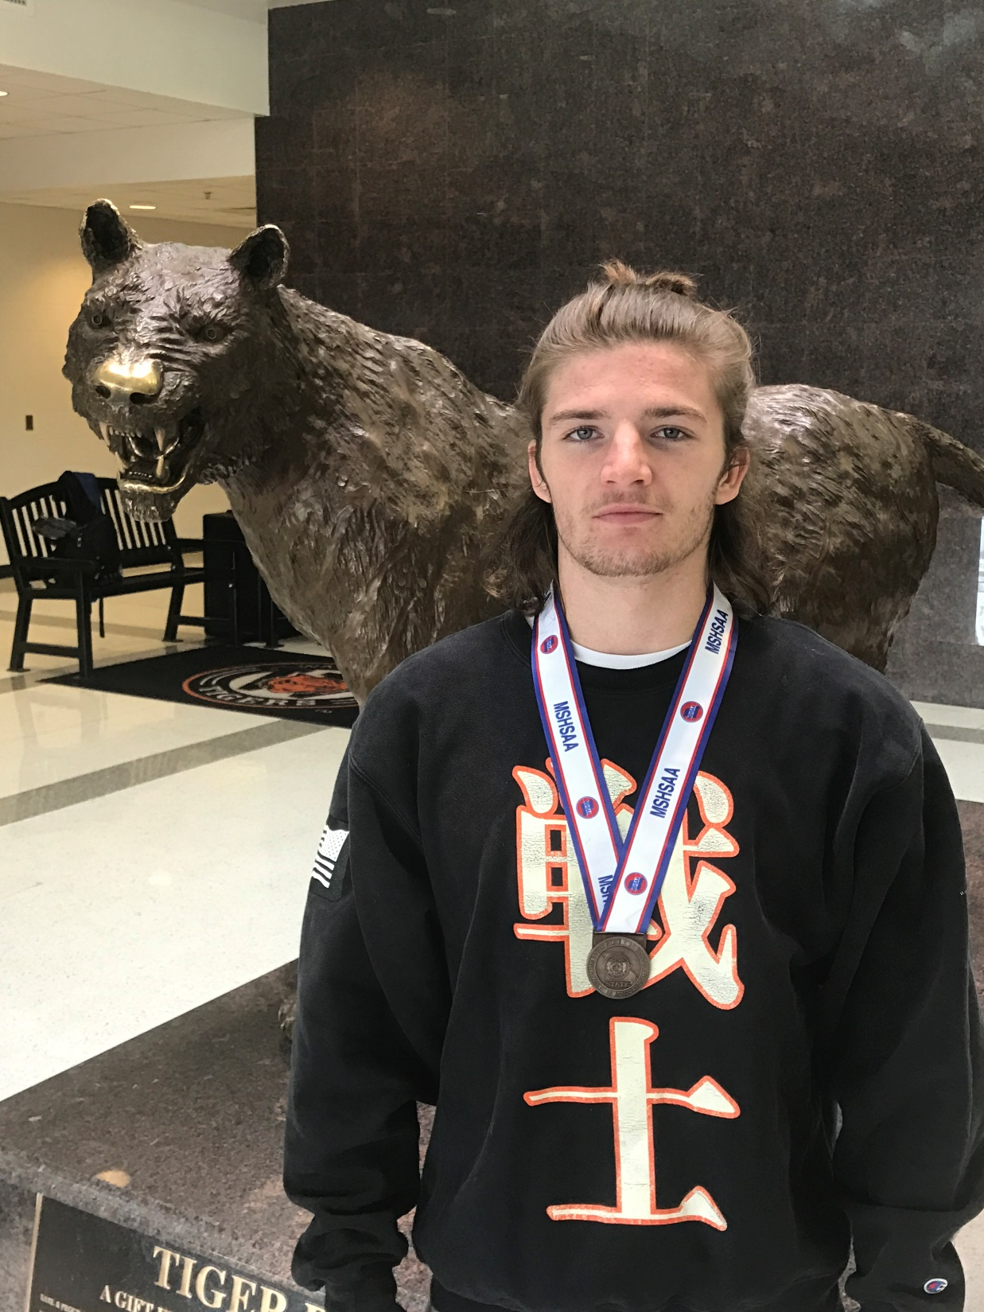
NEED FOR MULTI-SPORT ATHLETES
TIME COMMITMENT ISSUES
SPECIALIZATION
UNIFICATION OF SCHOOL COMMUNITY
LIFT TOGETHER =
SUCCEED TOGETHER
FAIL TOGETHER
HELP EACH OTHER
GROW CLOSER

Slide 4
PHILOSOPHY OF TPT
ALL ATHLETES LIFT
4-DAYS A WEEK
NON-NEGOTIABLES
LIFT ON GAME DAY
COACHES PUSH ATTENDANCE
CORE LIFTS
BENCH
SQUAT
CLEAN

Slide 5
TPT - Powerlifting
Notes:
Boys placed 8th in State - 5 boys medaled
All three girls medaled
Safely & successfully complete all 3 attempts in each lift - only 2 failed attempts out of 39 - check
Have no disqualifying lifts (based on state power lifting meet rules) - only 3 out of 39 lifts were DQ - check
Gain confidence and experience - check
Achieve Personal Records in all lifts - check
They competed as individuals and as a team (12 lifters or less) in the following lifts;
Bench Press
Dead Lift
Back Squat

Slide 6
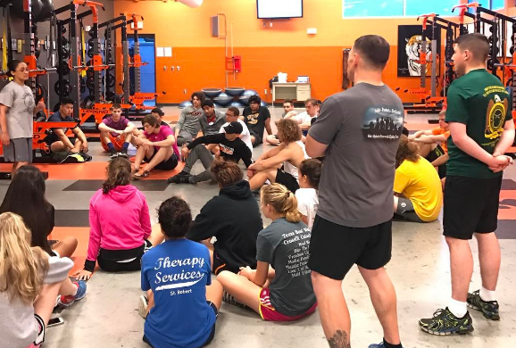
TPT – FLW OUTREACH
Notes:
LTC Steve Caruso
Company and Battalion Commanders
I've coordinated with the military to do a monthly Wednesday morning workout with our student athletes. In addition to the instant camaraderie, we're also collaborating on the message we've chosen to share with our students.
We will have different levels each month and choose a topic of discussion for that month's workout. This week we will have company commanders and battalion commanders joining us for our workouts (5 males / 2 females).
Our collaborative topics of discussion are;
Higher education
Technical Skills
Communication
Our main goal is to create more synergy in hopes that our combined efforts exceed the individual effects. We had a great "trial session" before break and the feedback from the military has been overwhelmingly positive.
My plan is to grow this into a partnership where our students begin to help choose our topics and our "leaders" begin to prepare and express their own views/opinions in more of a forum setting versus us lecturing.

Slide 7
FIRST SEMESTER RESULTS
LIFT | MALE | FEMALE
HANG CLEAN | 19.79% | 22%
BACK SQUAT | 17.71% | 16%
BENCH PRESS | 16.20% | 12%
Notes:
RECORD MAXES IN RACK PERFORMANCE
WILL HAVE ALL ATHLETES NUMBERS FROM THEIR SCHOOL CAREER.

Slide 8
MIDDLE SCHOOL Mondays and Wednesdays 4:00 – 5:15 pm. 35 Minute Lift – 30 minute Performance Training Introduction to TPT

Slide 9
TIGER STRONG

