Slide 1
Building better leaders Student athlete leadership training
Mike McGurk, CMAA
Lee’s Summit North HS
Mike.McGurk@lsr7.net

Slide 2
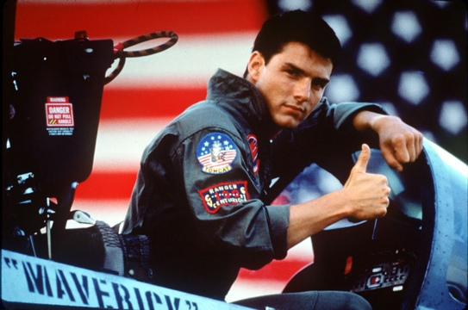
“I feel the Need- the need to Lead”
What are the benefits of a good leadership program?
Personal growth for student athletes
Reinforces our emphasis of our department goals
Less team discipline; teammates holding each other accountable

Slide 3
What is your purpose?
What are your goals for the group?
Have a clear and precise vision and or mission:
Mission Statement: Our mission is to provide effective leadership skills to all members for the benefit of personal growth as well as team growth. We hope to create a positive atmosphere for all of our teams and our entire activity program.

Slide 4
The selection process-
Only captains? -our group is called SAAC and is not captains only
How many students per grade level? -9th-5, 10th-7, 11th-7, 12th-8
How many total students? -27
What is your screening process? –work through MS,HS faculty and current SAAC members; GPA requirement; attendance requirement; citizenship requirement

Slide 5
First SAAC Meeting- MAY
Elect officers
Get to know you ice breakers
Discuss program evaluations from previous year
Prepare for Summer Sportsmanship Summit

Slide 6
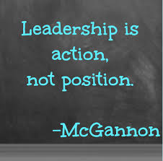
SAAC Officers
President- Macho Man Volleyball, Polar Plunge- Community Service- SR
Vice President- Senior Citizen Prom, Bronco Time Meetings- JR
Sgt. of Arms- Monthly Ice Breakers, Graduation Volunteers- Any grade

Slide 7
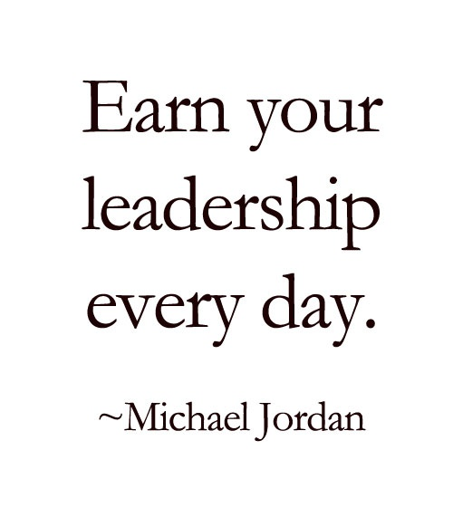
Leadership Program Components
Lunch and Learn
Student Led Activities
Community Service- Servant Leadership
Leadership Workshops

Slide 8
Lunch and Learn
Meet once a month- during lunch- for about 1 hour
Agenda
Ice Breaker- Sgt. of Arms
Open discussion about LSN issues/topics
Book talk

Slide 9
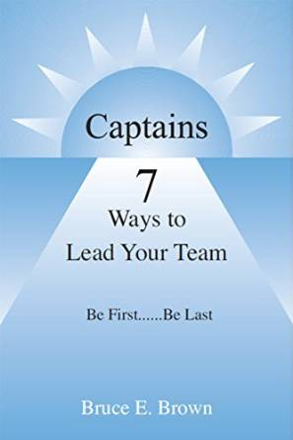
Resources- Book Talk Leadership Library
Bruce Brown- Captains- 7 Ways to Lead Your Team
Jeff Janssen- Team Captains Leadership Manual
Jon Gordon- The Hard Hat
Cory Dobbs- Becoming a Team Leader

Slide 10
Student Led Activities
Missouri National Guard- Team Building Activities
Result of the first year surveys- kids wanted more activities
Kids are divided into groups- we meet once a month
Entirely student led and student driven- we now invite one member of each team to join us

Slide 11
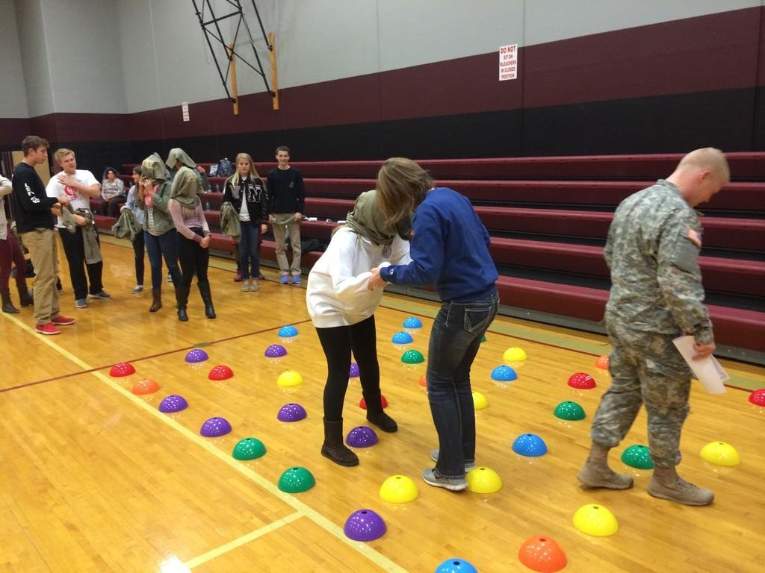
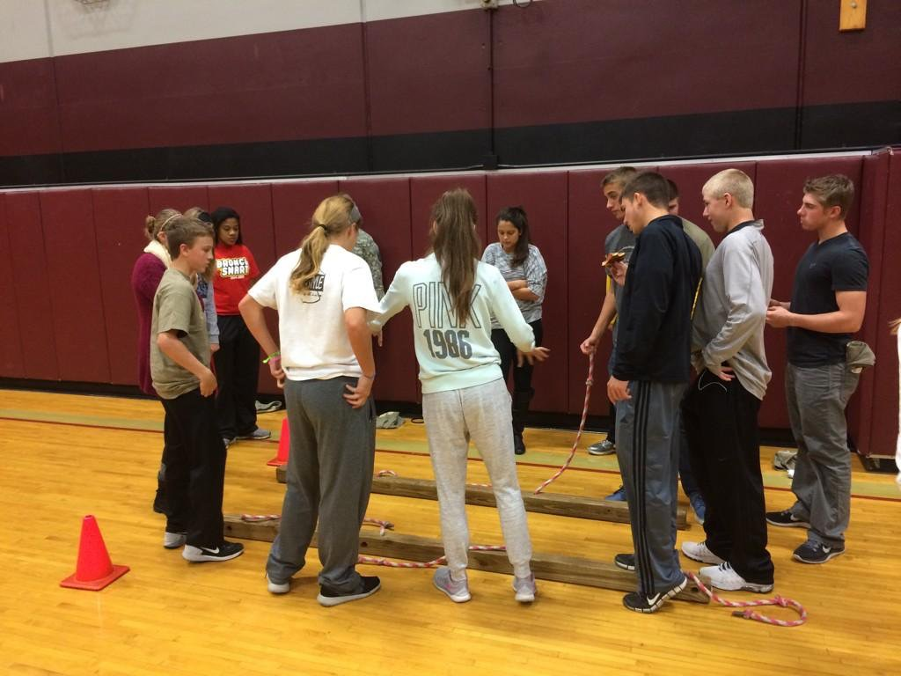
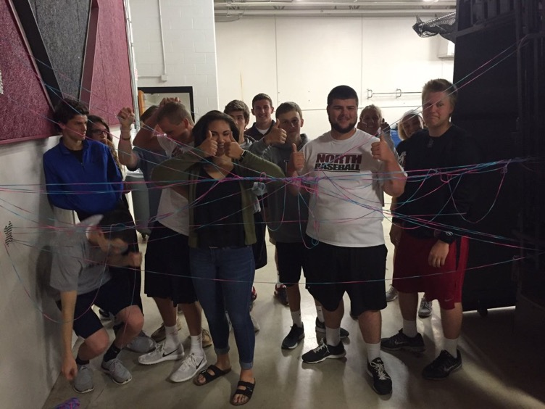
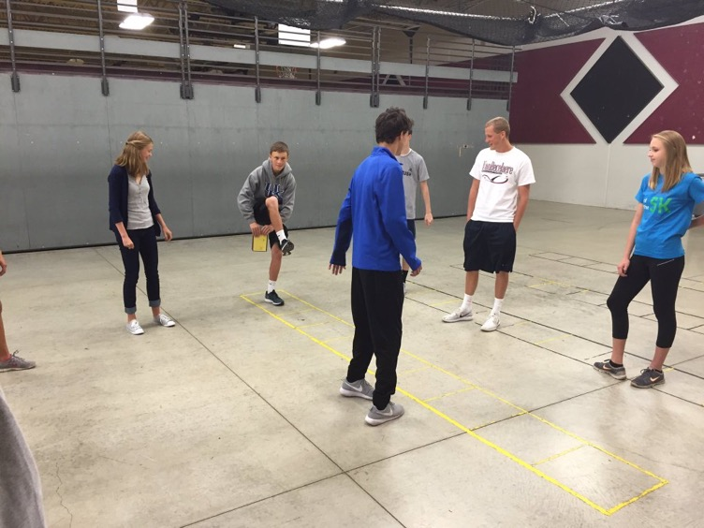
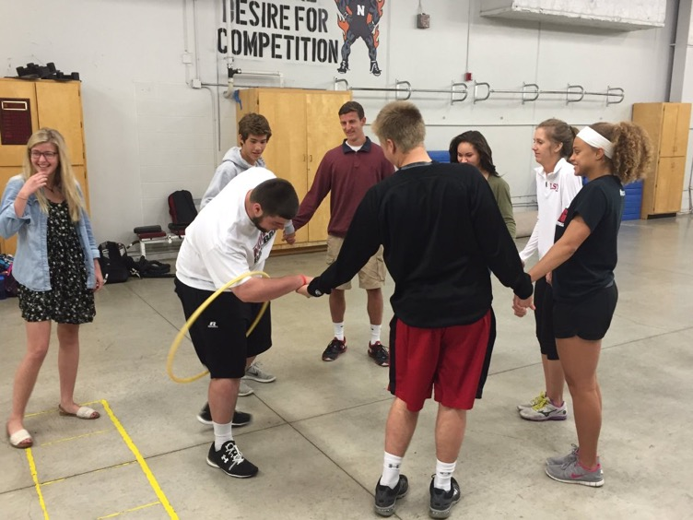

Slide 12
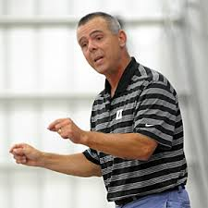
Leadership Workshop
Greg A. Dale, Ph.D. is a Professor of Sport Psychology and Sport Ethics at Duke University. He is also the Director of the Sport Psychology and Leadership Programs for Duke Athletics.
Attempt to bring him in once every 4 years
Leadership workshop for our SAAC group as well as presentations for coaches and parents

Slide 13
Chick- FiL- A Leadership Academy
Work with your local Chick-Fil-A store
They sponsor the entire program- bring lunch for the kickoff
Approximately 20-30 students in the program
Servant leadership projects and team building activities

Slide 14
Measuring Success
Student surveys- google forms
Individual written responses
Exit conversations with seniors
Coaching surveys- monthly
Data- discipline issues in and out of school

Slide 15
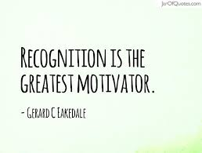
Recognition
Senior Athlete Award Luncheon
All senior SAAC members are presented a plaque with special mention of the president
“This is the coolest award I have ever received.”
T-shirts for all members

Slide 16
Summary
Have a clear purpose
Decide on a selection process, numbers
Four main components- Lunch & Learn, Student Activities, Servant Leadership, Leadership Workshop
Evaluate
Recongize

Slide 17
Questions??? Comments???
Contact Information:
Mike McGurk
Mike.McGurk@lsr7.net
816-365-6471 (cell)

